Slide 1


Optimizing Superhero U Ad Campaigns Performance Through Data-Driven Insights
Data Transformation, Visual Storytelling, & Tailored Recommendations

Slide 2

Team 3 – Excelerate Data Analysts
Michael Adesina
Shadman Rahman
Team Lead
Project Manager
Karunakar Nuvvula
Team Member
TEAM 3

Slide 3


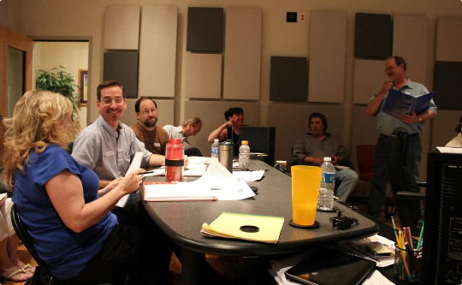
What is Superhero U?
Youth Leadership Event
Empowering young individuals to develop leadership skills and make a difference.
GlobalShala Initiative
A global program fostering education and personal growth across cultures.
Targets Students & Educators
Designed to support both learners and teachers in achieving their fullest potential.
TEAM 3

Slide 4



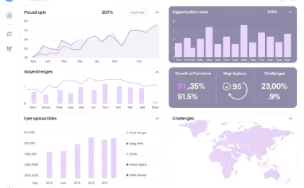

How Facebook Ad Campaigns Work
Ad Creation
Targeting
Impressions
Results
Creating an Ad with a specific goal and outcome.
Defining the target audience to reach the right people
The number of times your ad is shown and clicked
Track key performance metrics to measure success
Key Metrics
CPC (Cost per Click)
CTR (Click-Through Rate)
CPR (Cost per Result)
ULC (Unique Link Clicks)
TEAM 3

Slide 5
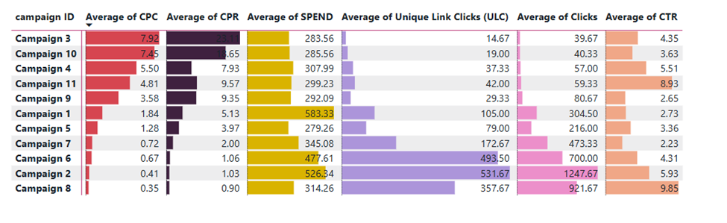
Performance Snapshot: All Campaigns
Campaign
CPC
CTR
CPR
ULC
3
₹7.9
Low
High
Low
10
₹7.5
Low
High
Low
8
₹0.4
High
Low
High
11
₹0.35
High
Low
High
Not all high-spend campaigns deliver results; some drive cost, not clicks.
TEAM 3

Slide 6

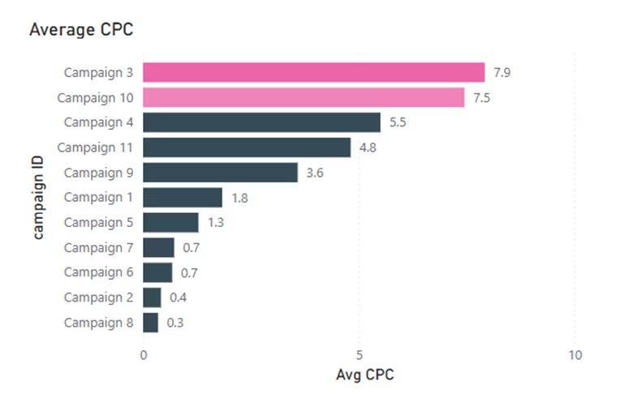
Cost Per Click (CPC) Breakdown
Campaigns 3 & 10 Lead in CPC Cost
Campaign 3
₹7.9 per click
Campaign 10
₹7.5 per click
Others
Up to 20x less costly
They cost up to 20 times more per click than efficient campaigns.

Slide 7
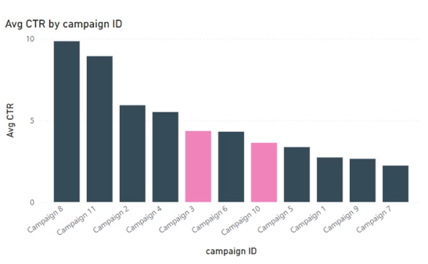
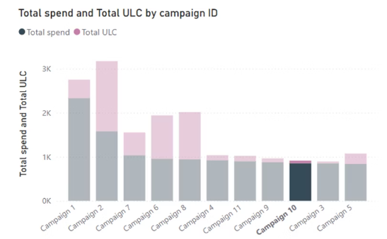
Click-Through Rate (CTR) & ULC Gap
High Spend, Low Engagement
Lowest CTR Campaigns
Campaigns 3 & 10 have the lowest click-through rates
High Spending
Significant budget spent without effective results
Despite high spend, campaigns 3 and 10 fail to generate meaningful interaction.
TEAM 3

Slide 8
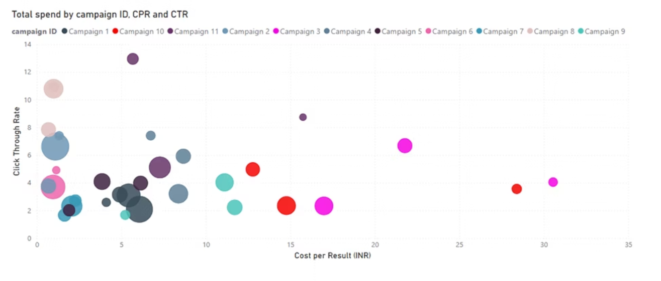
Performance Score & Root Cause
Why Campaigns 3 & 10 Underperform
Key Issues
Root Causes
CTR below median
Ineffective targeting
CPC above 75th percentile
High CPC, low ROI
Poor 25-34 age group engagement
Weak creative alignment
TEAM 3

Slide 9
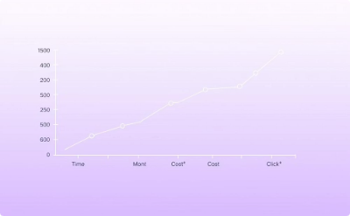
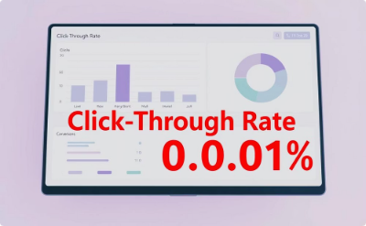
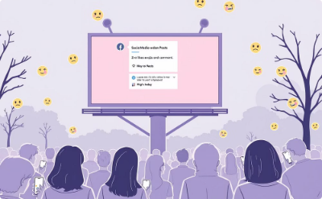
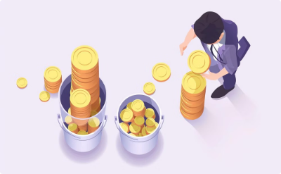
Recommendation
Discontinue Campaigns 3 & 10
High CPC
Low CTR
Weak Engagement
Budget Redirect
Campaigns 3 & 10 have the highest cost per click
These campaigns struggle to engage clicks effectively
Limited user interaction and interest observed
Funds shifted to Campaigns 8 & 11 with better performance
TEAM 3

Slide 10

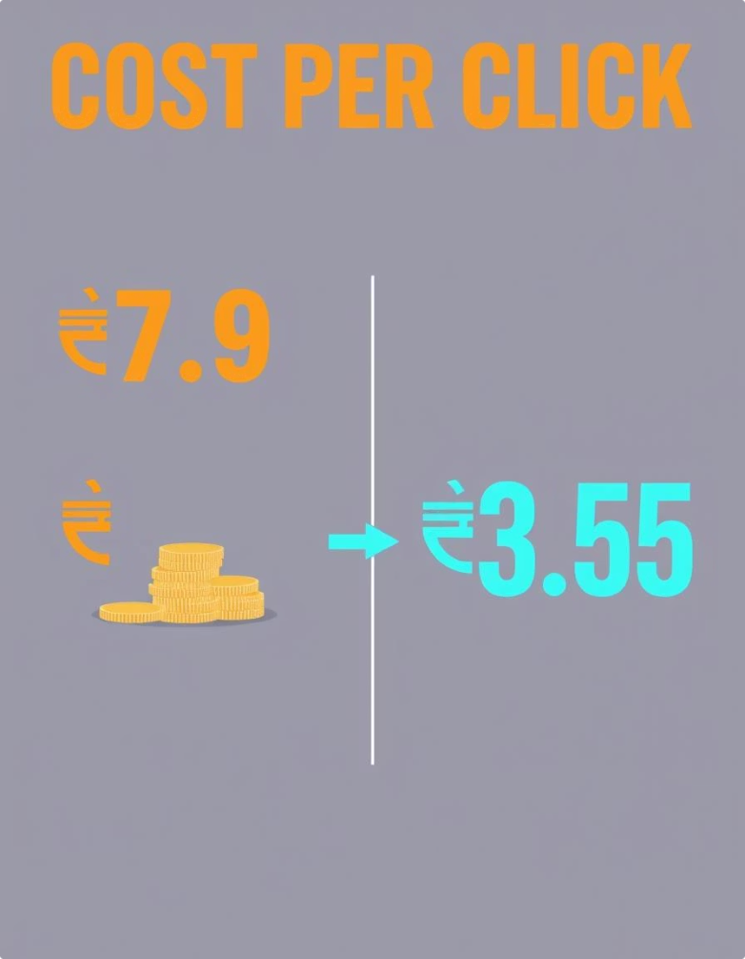
Closing Remark
Campaigns 3 & 10: Discontinue to Save. Redirect to Perform.
Our analysis clearly shows inefficiency—invest where it counts.

Slide 11
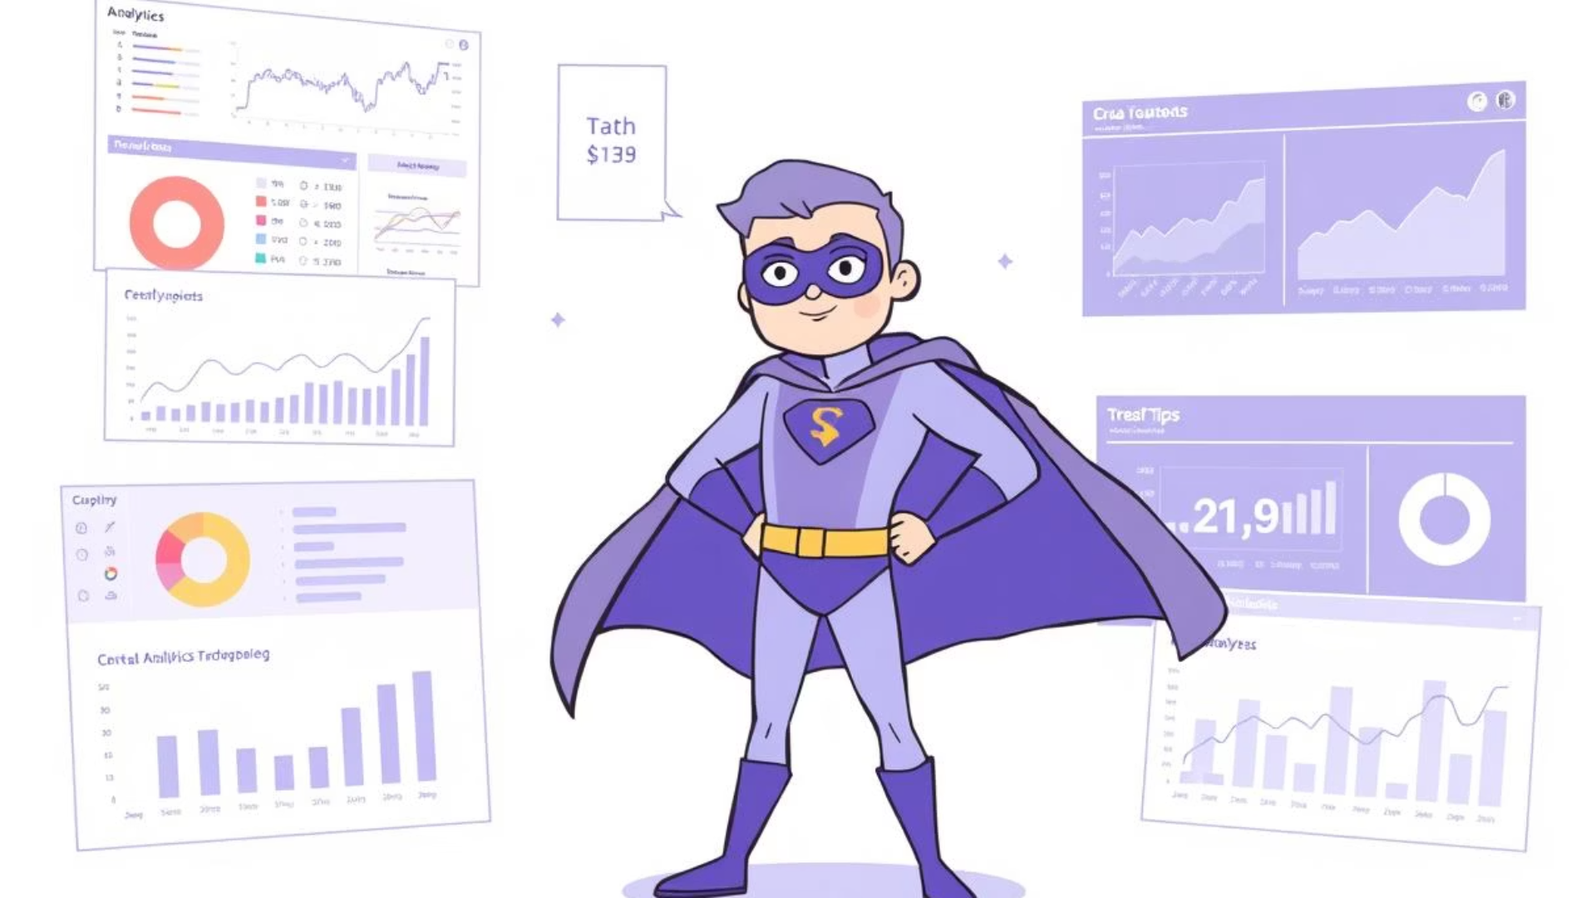
THANK YOU!

